Slide 1
CEPC HCAL Readout Electronics

Slide 2
Content
Background
CEPC Calorimeters
CEPC HCAL
USTC SDHCAL
SDHCAL Readout ASIC
Design of the Test-Board
Introduction of Microroc
Design of the Phase 1 Test-Board
Progress
Future Work
Full Test of Detector
Design a Read-out Array

Slide 3
Content
Background
CEPC Calorimeters
CEPC HCAL
USTC SDHCAL
SDHCAL Readout ASIC
Design of the Test-Board
Introduction of Readout ASIC
Design of the Phase 1 Test-Board
Progress
Future Work
Full Test of Detector
Design a Read-out Array

Slide 4
CEPC Calorimeters
Key Calorimeters
Electromagnetic calorimeter (ECAL)
Hadron calorimeter (HCAL)
Designed for precise energy measurements of electrons, photons, taus and hadronic jets.
Basic Resolution Requirements
ECAL: 16%/√(𝐸(𝐺𝑒𝑉))
HCAL: 50%/√(𝐸(𝐺𝑒𝑉)).
To achieve these, a Particle Algorithm oriented calorimetry system is being considered as the baseline design.

Slide 5
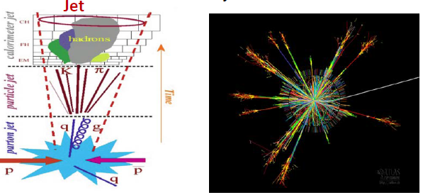
CEPC Calorimeters
Particle Flow Algorithm (PFA)
Charged particles –>tracker
Photons – >electromagnetic calorimeter
Neutral hadrons –> hadronic calorimeter
Approximately 72% of the jet energy is measured
Both ECAL and HCAL require high granularity

Slide 6
CEPC HCAL
HCAL
A high-granularity HCAL plays an essential role in CEPC. It allows separation of energy deposits from charged and neutral hadrons. The measurement accuracy of the neutral hadrons is the leading contribution to the jet energy resolution for jets with energy up to 100GeV.
The HCAL is a sampling calorimeter with steel as the absorber and scintillator tiles or gaseous devices with embedded electronics.

Slide 7


CEPC HCAL
HCAL Detector Options
Absorber: steel
Active layers: Gaseous detector
AHCAL
Scintillator + SiPM + SPIROC(ASIC), 8148channels,1m³
Analog Hadron Calorimeters(AHCAL).
High power consumption, expensive readout electronics
HCAL
DHCAL
GEM/RPC/Micromegas + DCAL(ASIC), $4×{10}^{5}$ chn/m³
A hadron calorimeter with only one threshold readout is called a Digital Hadron Calorimeter (DHCAL).
Simple, but poor accuracy. Hard to satisfy PFA
SDHCAL
GEM/RPC/Micromegas + HARDROC(ASIC), $4×{10}^{5}$ chn/m³
A more general calorimeter with multi-threshold readout (e.g. 3 thresholds) is therefore also considered, a so-called Semi-Digital Hadron Calorimeter (SDHCAL).
A balanced choice for CEPC HCAL

Slide 8
USTC SDHCAL
Architectural of the SDHCAL
A scheme of the ASU used to readout 1m² detector
Absorber(Fe, W)
Sensor(RPC,MM,GEMTHGEM)
,
)
PCB
?
cm

Slide 9
SDHCAL Readout ASIC
Hardroc (HAdronic Rpc Detector Read-Out Chip)
Microroc (MICRO mesh gaseous structure Read-Out Chip)
Comparison
Parameters | Hardroc | Microroc
Dynamic range | 10fC ~ 10pC | 2fC ~ 500fC
Channel per ASIC | 64 | 64
Shaper | 3 fast shapers per channel | 2 adjustable shapers per channel
Threshold | 3 thresholds | 3 thresholds
Power consumption | 10μW/Channel | ≈0 (Standby mode, power-pulsed)

Slide 10
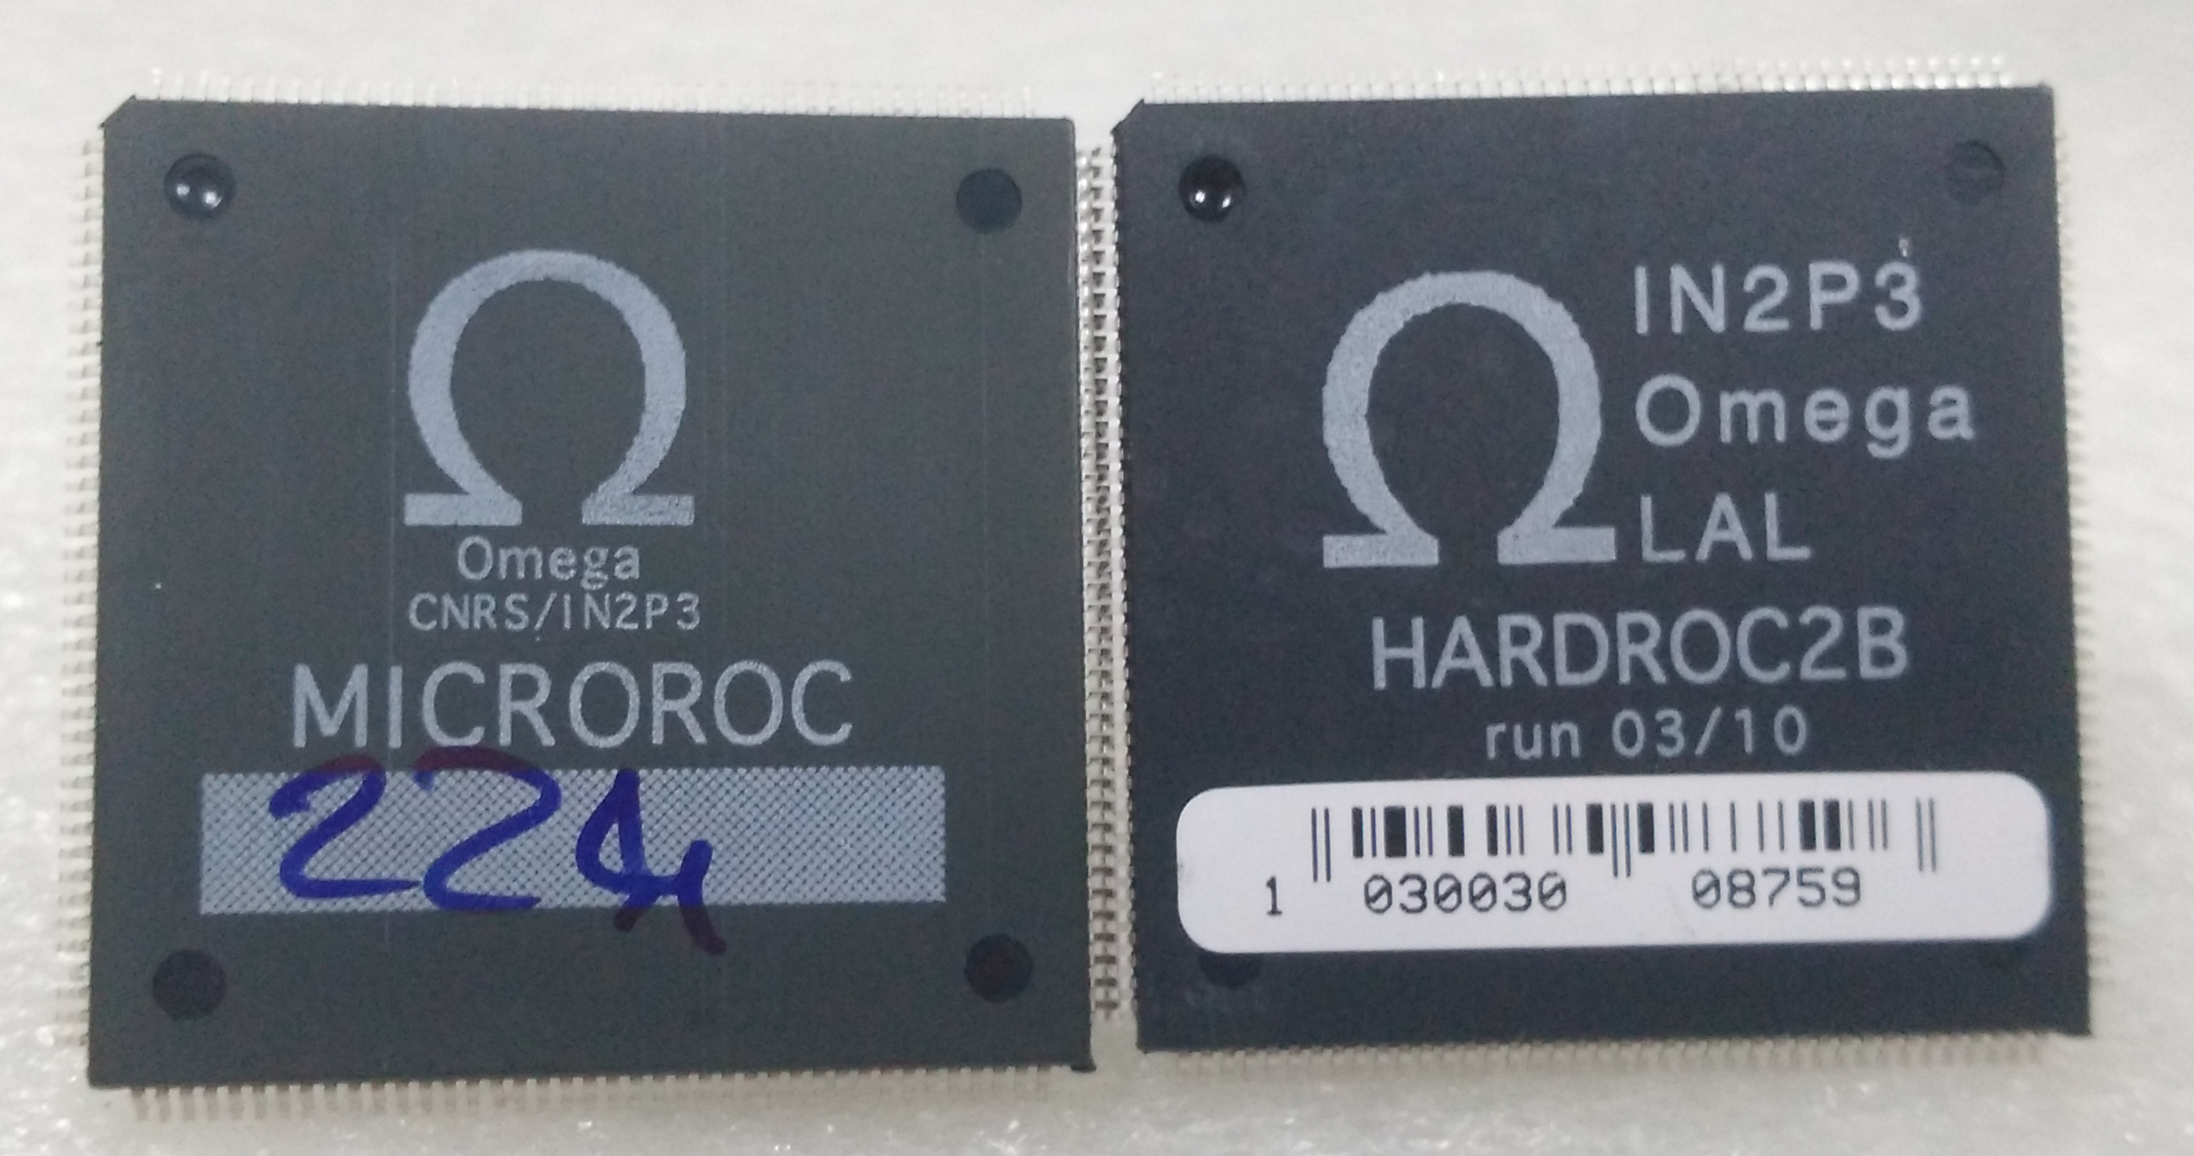
SDHCAL Readout ASIC
We choose GEM detector as our phase-I detector. Considering the dynamic range and other factors, the proper ASIC for GEM is Microroc

Slide 11
Content
Background
CEPC Calorimeters
CEPC HCAL
USTC SDHCAL
SDHCAL Readout ASIC
Design of the Test-Board
Introduction of Microroc
Read-Out Structure for Future
Design of the Phase I Prototype
Progress
Future Work
Full Test of Detector
Design a Read-out Array

Slide 12
Introduction of Microroc
Over view
Analog Part
160 pin QFP package or bare die
Low noise PAC: < 2fC
2 adjustable shaper: high gain and low gain
3 discriminators and triple 10-bit DAC for threshold
4 bit-DAC for base line adjustment
Analog to Digital Interface
RS to latch the trigger
Single channel data convert to 2-bits.
Digital Part
Data length for one fire is 160-bits(Including header and the Brunch ID)
160bits*128 RAM
Open collector buffer
Redundancy of the OC lines

Slide 13
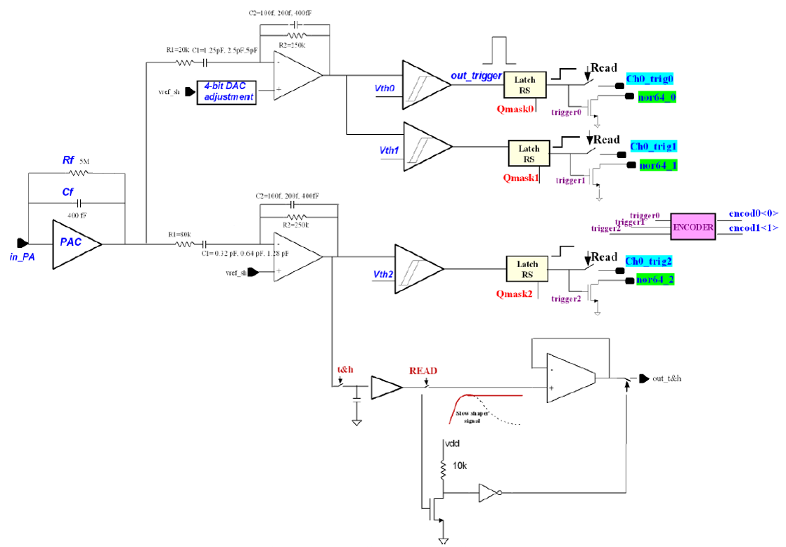
Analog Part of Microroc
High Gain
Base line adjust
Low Gain
1fc~500fC
The noise of the PAC have been simulated and found equal to 0.25 fC which allows to set the threshold of the discriminator that follow the HG shaper to a very low value such as 2fC.

Slide 14
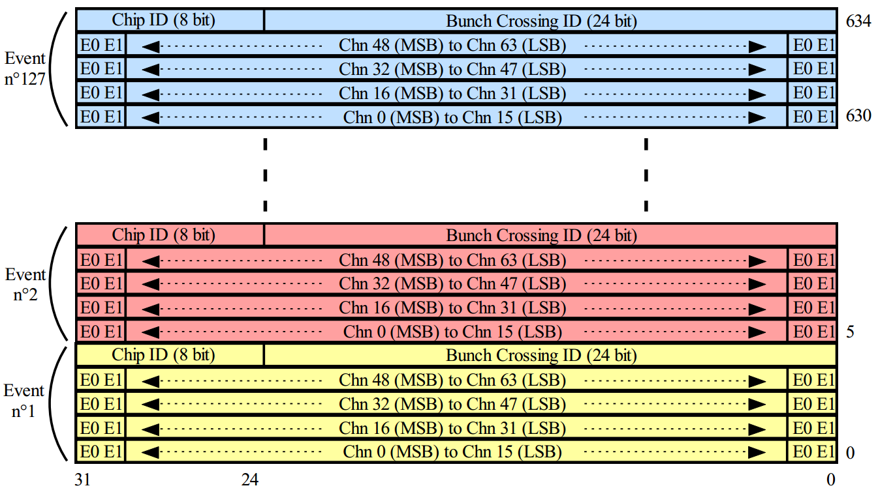
Digital Part
Single Channel Encode
RAM Data Structure
Max event:127
<Discri2> | <Discri1> | <Discri0> | Encode<1> | Encode<0>
0 | 0 | 0 | 0 | 0
0 | 0 | 1 | 0 | 1
0 | 1 | 1 | 1 | 0
1 | 1 | 1 | 1 | 1

Slide 15
Digital Part
Redundancy of OC Line
To ensure the reliability the Doutb, transmitonb, start and end readout signals have been doubled
Daisy Chain
The ASIC can work in daisy chain mode. Thus in ASU, the ASIC can be arranged in a matrix. Each row lay out in daisy chain and each column in parallel
Power Consumption
Max power consumption: 10μW/Channel ->640μW/ASIC
The power pulsing mode consists in switching off the bias current of the various cell in interbunch
With power pulsing and 0.5% duty-cycle, mean power consumption is 3.2μW/ASIC

Slide 16
SDHCAL Readout for Future

Slide 17
ECAL&HCAL Readout For Future

Slide 18
Phase I Prototype
Structure of Prototype
The connector among boards is 4-layers soft PCB
All the boards are completed

Slide 19
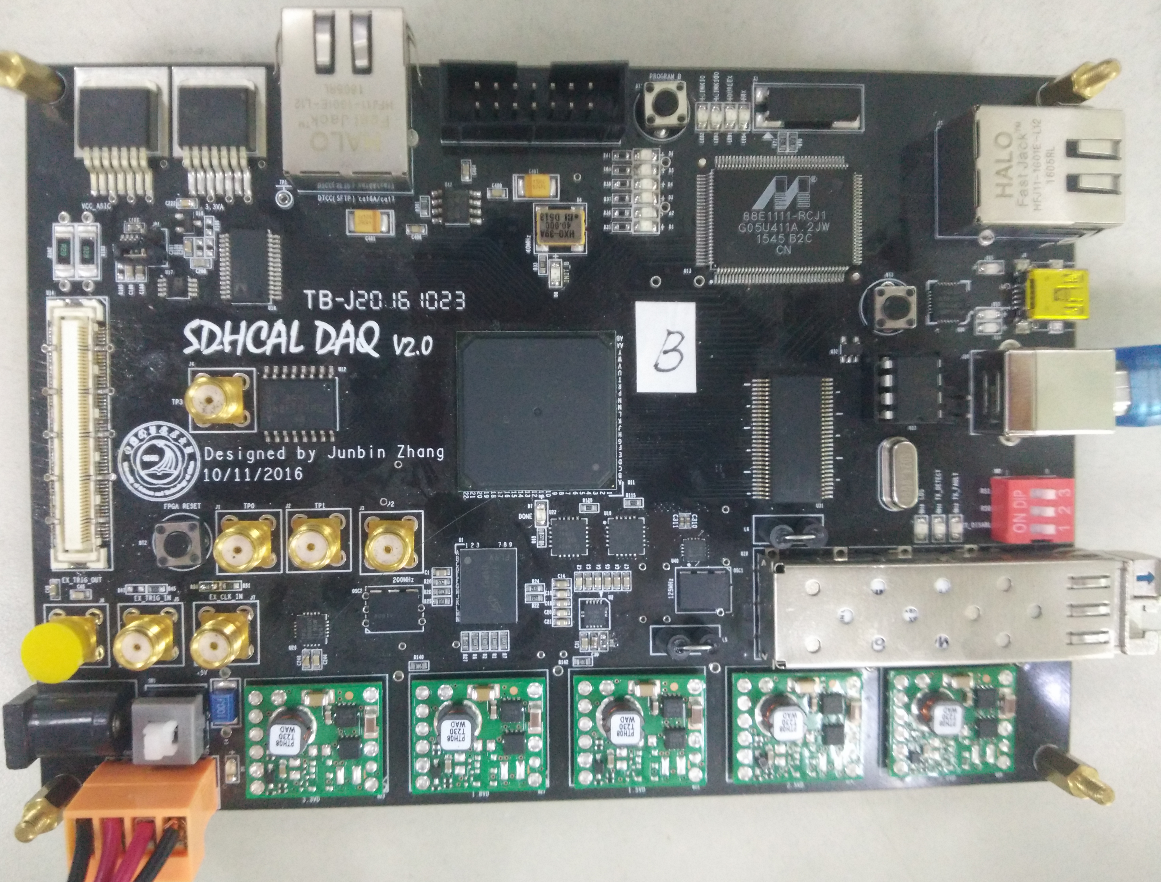
Phase I Prototype
SDHCAL DAQ Board

Slide 20
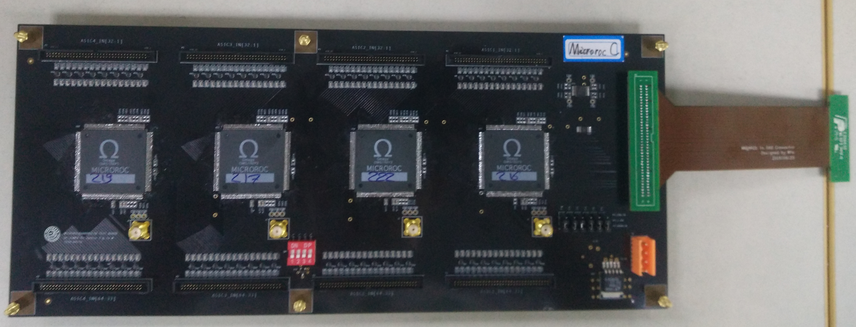
Phase I Prototype
Microroc Test Board

Slide 21
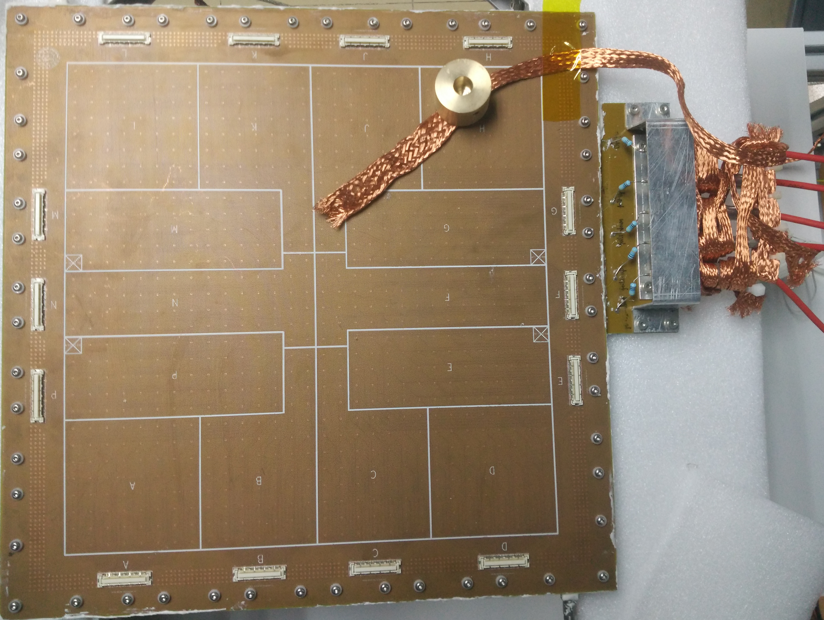
Phase I Prototype
GEM Read-Out Pad Array

Slide 22
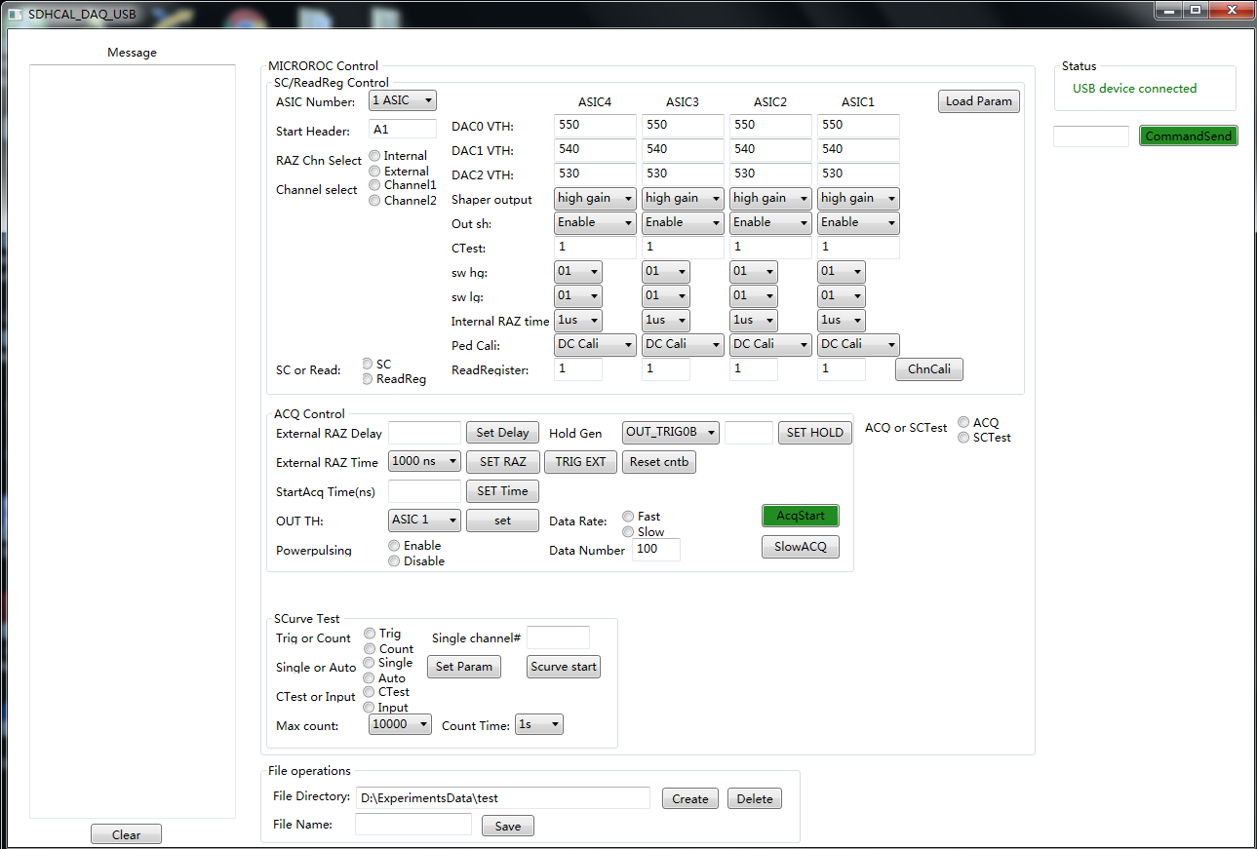
Progress
FPGA Logic Completed
DAQ Software Completed (C# WPF Program)

Slide 23
Progress
Single ASIC Electronics Test Completed
Linearity of triple 10-bits DAC
Uniform of shaper output base line
S-Curve Test—”Trigger-efficiency vs Threshold”
Linearity between charge and shaper output
Hit Map of the Detector

Slide 24
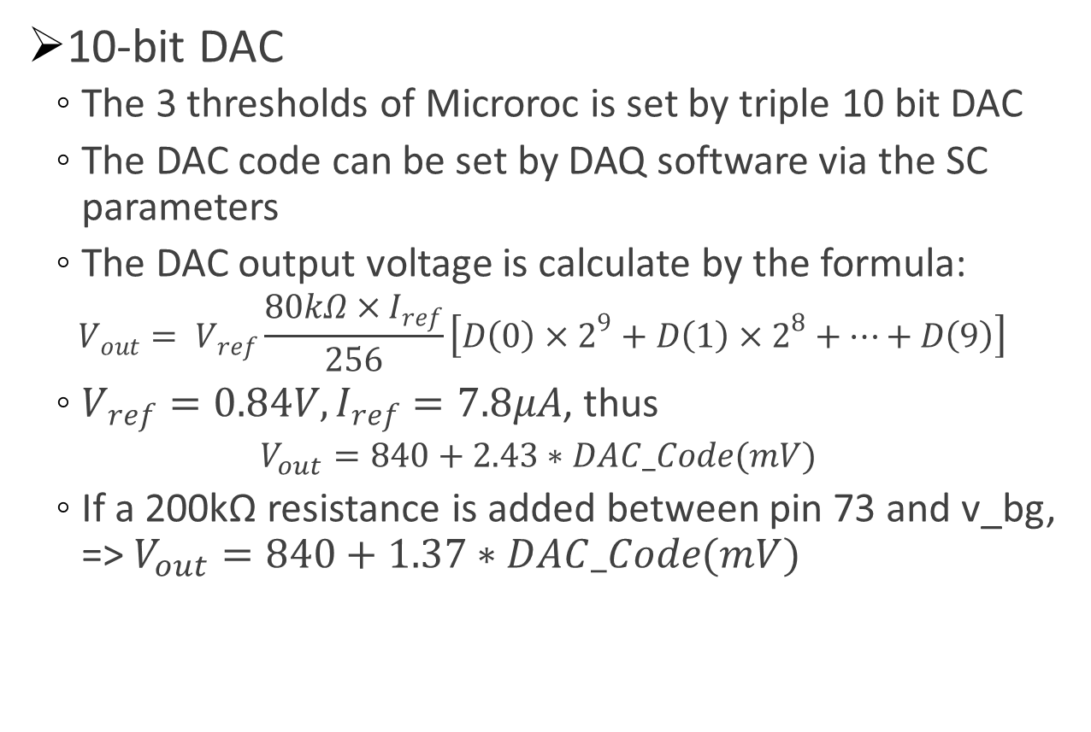
Linearity of 10-bit DAC
10-bit DAC
The 3 thresholds of Microroc is set by triple 10 bit DAC
The DAC code can be set by DAQ software via the SC parameters
The DAC output voltage is calculate by the formula:
$$V_{out}= V_{ref}\frac{80kΩ×I_{ref}}{256}\left[D\left(0\right)×2^{9}+D\left(1\right)×2^{8}+…+D\left(9\right)\right]$$
$V_{ref}=0.84V,I_{ref}=7.8μA$, thus
$$V_{out}=840+2.43∗DAC_Code(mV)$$
If a 200kΩ resistance is added between pin 73 and v_bg, => $V_{out}=840+1.37∗DAC_Code(mV)$

Slide 25
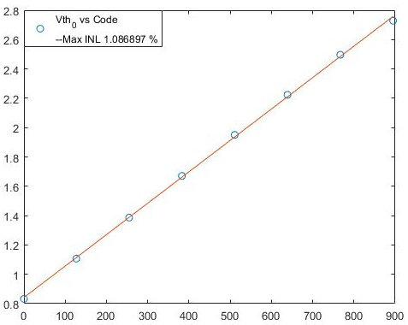
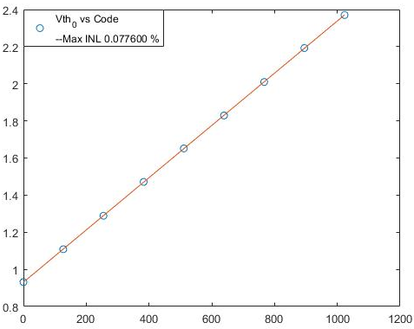
Linearity of 10-bit DAC
Result
We test two kinds of DAC. One has the 200k resistance between pin 73 and v_bg and the other does not.
The second result is optimim
Slope:2.43 mV/DAC Unit
Max INL: 1.0869%
Slope:1.37 mV/DAC Unit
Max INL: 0.0776%

Slide 26
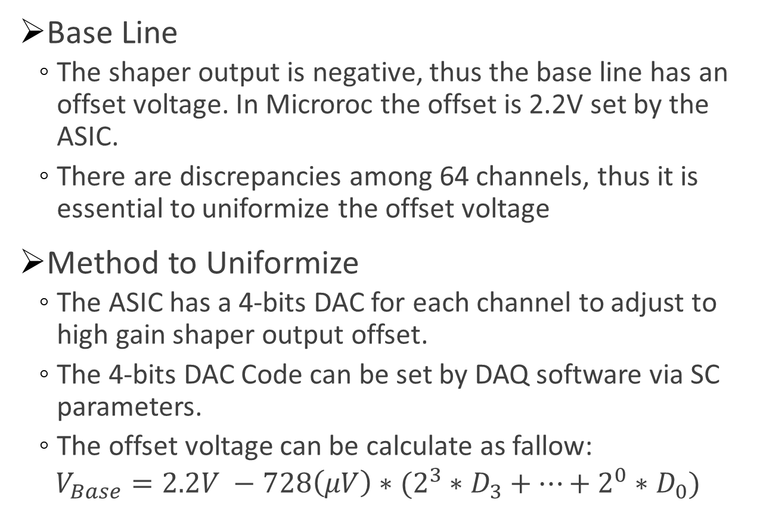
Uniform of Base Line
Base Line
The shaper output is negative, thus the base line has an offset voltage. In Microroc the offset is 2.2V set by the ASIC.
There are discrepancies among 64 channels, thus it is essential to uniformize the offset voltage
Method to Uniformize
The ASIC has a 4-bits DAC for each channel to adjust to high gain shaper output offset.
The 4-bits DAC Code can be set by DAQ software via SC parameters.
The offset voltage can be calculate as fallow:
$$V_{Base}=2.2V −728\left(μV\right)∗(2^{3}∗D_{3}+…+2^{0}∗D_{0})$$

Slide 27
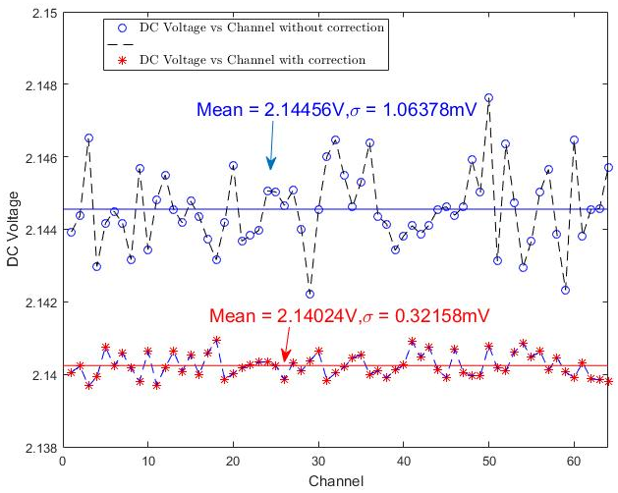
Uniform of Base Line
Result
After correction, the standard deviation of the offset voltage is 0.3215mV.

Slide 28
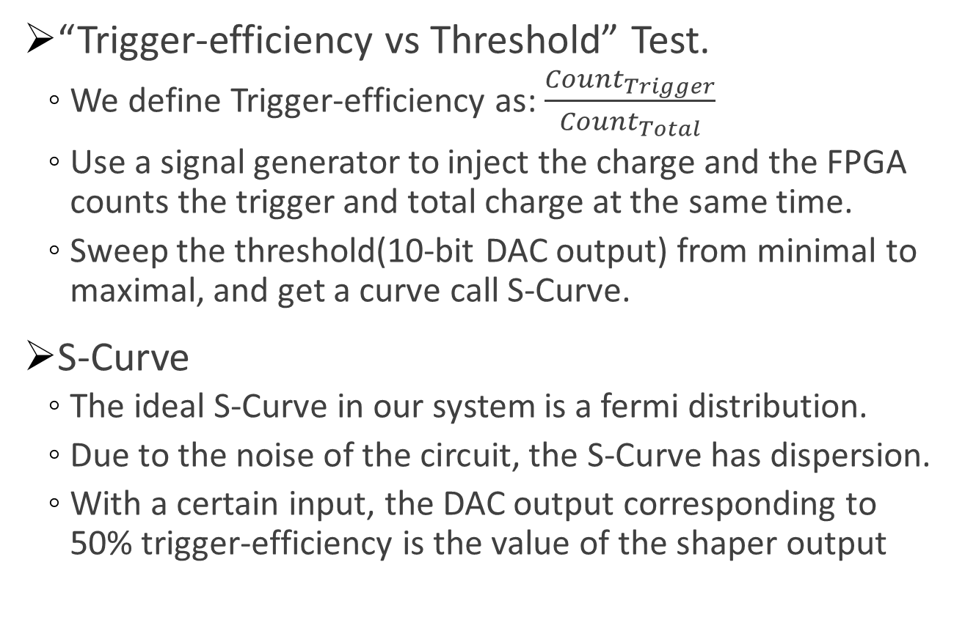
S-Curve Test
“Trigger-efficiency vs Threshold” Test.
We define Trigger-efficiency as: $\frac{{Count}_{Trigger}}{{Count}_{Total}}$
Use a signal generator to inject the charge and the FPGA counts the trigger and total charge at the same time.
Sweep the threshold(10-bit DAC output) from minimal to maximal, and get a curve call S-Curve.
S-Curve
The ideal S-Curve in our system is a fermi distribution.
Due to the noise of the circuit, the S-Curve has dispersion.
With a certain input, the DAC output corresponding to 50% trigger-efficiency is the value of the shaper output

Slide 29
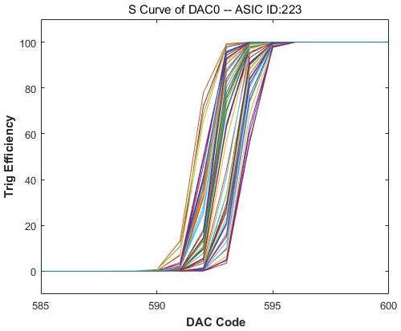
S-Curve Test
Result Without Input
Bigger DAC code means lower threshold. So when DAC code grows, the trigger-efficiency become higher.

Slide 30
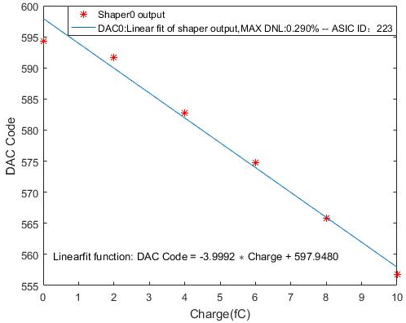
S-Curve Test
Small Charge Inject Test(< 10fC)
Choose the 50% trigger-efficiency DAC code as the threshold, and get the linear fit of charge and DAC Code
1fC Charge is corresponding to 3.9992DAC unit

Slide 31
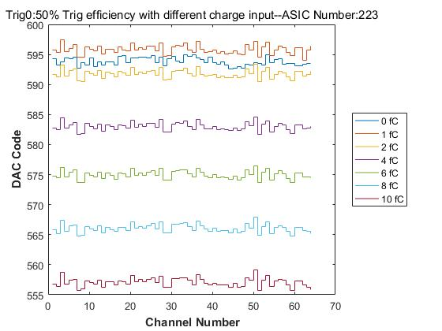
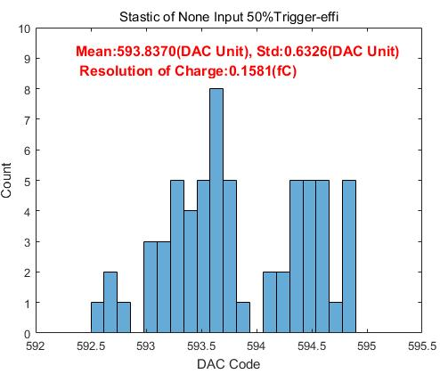
S-Curve Test
Noise of Electronics
Statistics of none input 50% trigger-efficiency DAC code
The standard deviation is 0.6326DAC unit corresponding to 0.1581fC

Slide 32
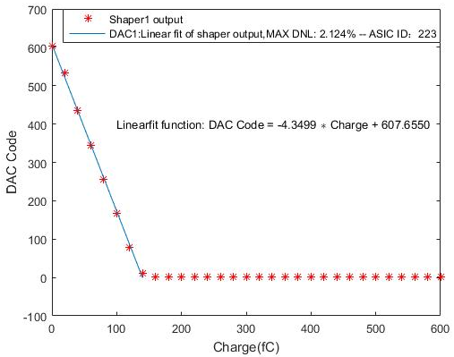
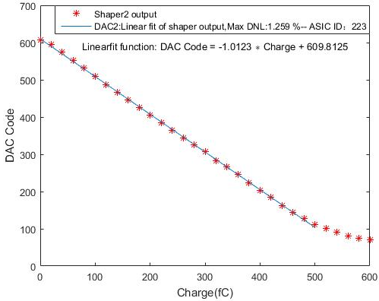
S-Curve Test
Linearity of Two Shapers
The linear range of high gain shaper is 0~140fC
The linear range of low gain shaper is 0~500fC

Slide 33
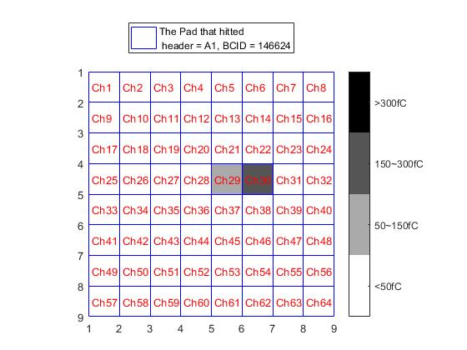
Hit Map
We use 8keV X-Ray to test our DAQ system and get the hit map

Slide 34
Content
Background
CEPC Calorimeters
CEPC HCAL
USTC SDHCAL
SDHCAL Readout ASIC
Design of the Test-Board
Introduction of Microroc
Design of the Phase 1 Test-Board
Progress
Future Work
Full Test of Detector
Design a Read-out Array

Slide 35
Full Test of Detector
We have measure the electronics performance of the Microrc and our test-board
The next step is to combine the Microrc with the GEM to get full test.
We will test follow parameters
Noise of base line
Homogeneity of read-out pads
Crosstalk between read-out pads
Detection efficiency of GEM

Slide 36
Design a Read-out Array
When all the test done, our next step is to design the ASU array.
ASIC in each row controlled in daisy chain mode and each column controlled in parallel

